Slide 1
LAB 3
CSE 102

Slide 2
Warm-up
Write a function which takes a rectangular integer array and two indices i, j and returns the element of the array which is located at the intersection of the ith row and jth column.

Slide 3
Answer
static int get(int[][] arr, int i, int j) {
return arr[i][j];
}

Slide 4
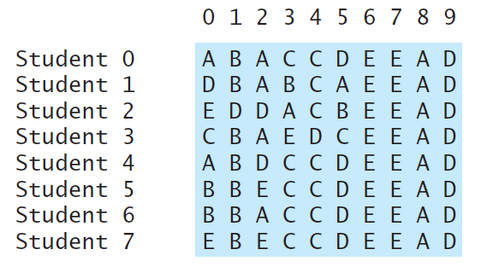
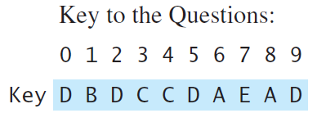
Question
Write a function which grades a multiple choice test. Assume that every student answers every question. Each correct answer gives +1 point and each wrong answer costs -1/4 points.

Slide 5
static double[] grade(char[][] answers, char[] key) {
// your code
}
public static void main(String[] args){
char[][] answers = {
{'A','D','E','E','A','D'}, // Student 1
{'D','E','E','A','D','D'}, // Student 2
{'A','D','E','E','D','D'}, // Student 3
{'C','C','E','A','C','A'}, // Student 4
{'A','D','E','C','C','B'}, // Student 5
{'A','E','E','A','E','B'}, // Student 6
{'C','B','A','A','D','B'} // Student 7
};
char[] key = {'A','D','E','A','C','B'};
double[] grades = grade(answers, key);
for(int i=0; i<grades.length; i++)
System.out.println(grades[i]);
}

Slide 6
Answer
static double[] grade(char[][] answers, char[] key) {
// your code
double[] grades = new double[answers.length];
for(int i=0; i<answers.length; i++)
for(int j=0; j<key.length; j++)
if(answers[i][j] == key[j])
grades[i] += 1;
else
grades[i] -= (double)1/4;
return grades;
}

Slide 7
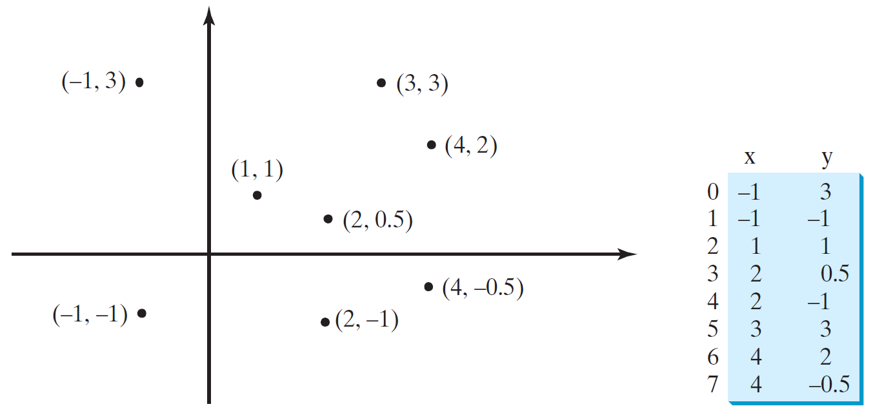
Question
Write a program which takes a 2-d double array representing points in 2-d space and prints the closest two points to the screen.

Slide 8
static double dist(double[] p1, double[] p2) {
return Math.sqrt(
Math.pow(p1[0]-p2[0], 2) +
Math.pow(p1[1]-p2[1], 2)
);
}
public static void main(String[] args){
double[][] points = {
{1.2, 2.3},
{-2, -1},
{-.3, 3.2},
{.11, .6},
{.1, -3},
{-2.1, 2.2},
{-1.6, 0.8},
{4.2, 1.1},
{3, 2.1},
{-2.1, -1.5}
};
// your code
}

Slide 9
Answer
double minDist = dist(points[0], points[1]);
double[] p1 = points[0];
double[] p2 = points[1];
for(int i=0; i<points.length; i++)
for(int j=i+1; j<points.length; j++)
if(dist(points[i], points[j]) < minDist) {
minDist = dist(points[i], points[j]);
p1 = points[i];
p2 = points[j];
}
System.out.println(p1[0] + ", " + p1[1]);
System.out.println(p2[0] + ", " + p2[1]);

Slide 10
Question
You are supposed to write a method which finds the students who got an AA grade from the Programming Languages - II course.
Names of students will be given as a string array and their grades (Midterm, BirDeha, Project and Final in that order) as a 2-d integer array. To get an AA, a student must have a final average of at least 90. Your method should print all the students which got an AA to the screen (returns nothing). The weights are as follows:
Midterm 25%
BirDeha 10%
Project 25%
Final 40%

Slide 11
String[] students = {
"ALI",
"MAHMUT",
"AYŞE",
"ZEYNEP",
"FATMA",
"KERİM",
"OSMAN",
"YASEMİN",
"NİYAZİ",
"RECEP",
"KAMİL"
};
int[][] grades = {
{80, 90, 70, 100},
{50, 60, 40, 80},
{100, 50, 70, 60},
{100, 90, 95, 100},
{80, 80, 85, 75},
{42, 66, 84, 94},
{79, 91, 89, 100},
{100, 85, 88, 75},
{25, 99, 85, 40},
{63, 59, 66, 33},
{87, 100, 100, 96}
};
printAAs(students, grades);
static void printAAs(String[] students, int[][] grades) {
// your code
}

Slide 12
Answer
static double calcAvg(int[] grades) {
return grades[0] * 0.25 +
grades[1] * 0.1 +
grades[2] * 0.25 +
grades[3] * 0.4
;
}
static void printAAs(String[] students, int[][] grades) {
for(int i=0; i<students.length; i++) {
if(calcAvg(grades[i]) >= 90)
System.out.println(students[i]);
}
}

Slide 13
Question
Consider an n by n table. For any cell in the table we define the neighborhood of a cell to be the cells located at right, left, up, down and all 4 diagonals (if they exist). Write a function which takes integers n, i, j and returns the number of neighbors of the cell, which is located at ith row and jth column.

Slide 14
Answer
static int countNeighbors(int n, int i, int j) {
// check the edges
int cond = 0;
if(i+1 == n)
cond++;
if(i == 0)
cond++;
if(j+1 == n)
cond++;
if(j == 0)
cond++;
switch(cond) {
case 4: return 0; // 1x1 table
case 2: return 3; // corner
case 1: return 5; // edge
default: return 8;// inside
}
}

Slide 15
Question
Write a function which given two square integer arrays and two integers i,j; writes the smaller array’s content into the bigger one such that the (0,0) cell of the small array coincides with (i,j) cell of the bigger array. You can assume that the first parameter is the bigger and the second parameter is the smaller array. (Don’t allocate new space, overwrite the bigger array and return it.)

Slide 16
Example
Input: paste(arr1, arr2, i, j)
where
arr1 arr2 i j
123 00 1 1
654 00
789
Output:
123
600
700

Slide 17
Answer
static int[][] paste(int[][] big, int[][] smol, int I, int J){
int smolHeight = smol.length;
int smolWidth = smol[0].length;
for(int i=I; i<I+smolHeight; i++)
for(int j=J; j<J+smolWidth; j++)
big[i][j] = smol[i-I][j-J];
return big;
}

